Slide 1
Bayes Rule
Fish 558; Day 3: 10h30-12h00

Slide 2
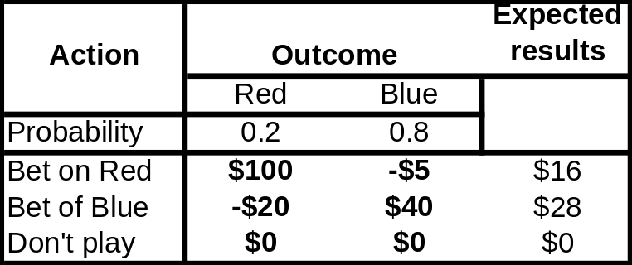
Decision Analysis Revisitied
Management
Actions
States of Nature
(Hypotheses)
Probabilities
Consequences of
Management Actions
Today (and the next several
lectures) we focus on how to
determine these probabilities

Slide 3
Why Bayesian Inference for Decision Analysis?
We need to know the (relative) probability to associate with each state of nature, i.e. P(H|Y) where H is the hypothesis and Y is the data.
The likelihood leads to P(Y|H) not P(H|Y). These two functions will be similar under some circumstances, but this is by no means: a) always the case, and b) easy to show.

Slide 4
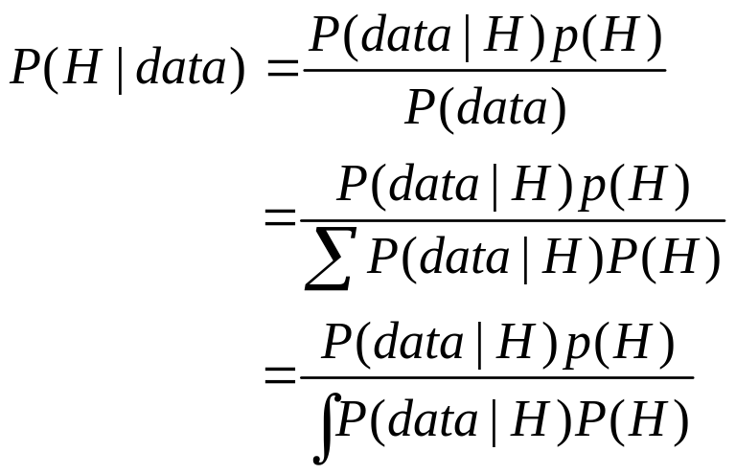
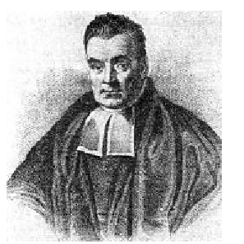
Bayes Law Basics-I
Bayes Law

Slide 5
Bayes Law Basics-II
Relative support for a hypothesis equals:
  the support given to the hypothesis by the data, P(data|H), times
  the support given to the hypothesis by prior beliefs, P(H), divided by
  the support from the data and the prior beliefs for all hypotheses, ΣP(data|H) P(H).

Slide 6
Bayes Law Basics-III
Notation:
  P(H||data) is the posterior probability distribution (or posterior).
  P(H) [or π(H)] is the prior probability distribution (or prior).
  P(data|H) [or L(data|H)] is the likelihood of the data given the hypothesis.
Note: that H need not be discrete.

Slide 7
Implementing Bayes Law
(Discrete cases)
Specify the data on which the analysis is to be based {data}.
Determine the prior probability for each hypothesis {P(H)}
Construct the likelihood of the data given the hypothesis {P(data|H) – this could involve a population model}.
Calculate the posterior distribution from the prior distribution and data (easier said than done!)

Slide 8
Example : Medical Diagnosis-I
There is a disease that is thought to occur in a proportion, θ, of 0.01 of the population.
A certain doctor notices that 99% of patients with the disease have symptom Z.
Let A be the event (datum) “having the symptom Z” and the event (hypothesis) B “having the disease”.
Calculate the probability of someone having the disease given that he / she has the symptom, if the probability of having the symptom, but not the disease is 0.1.

Slide 9
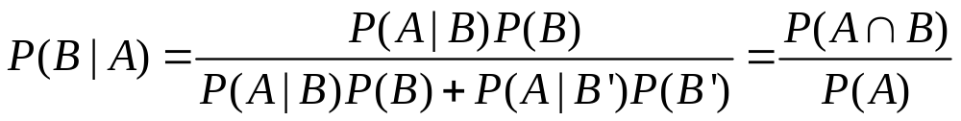
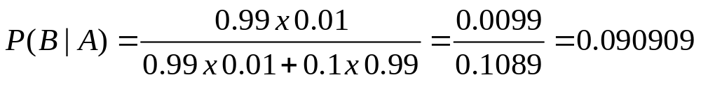
Example : Medical Diagnosis-II
Solution:
1. Summarize the information
P(B)=θ=0.01; P(A|B)=0.99; P(A|B’)=0.1
2. Write down Bayes law as we need to apply it:
3. Substitute and solve:
4. Interpret: Looks pretty hopeless – what happened?

Slide 10
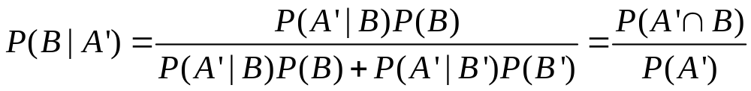
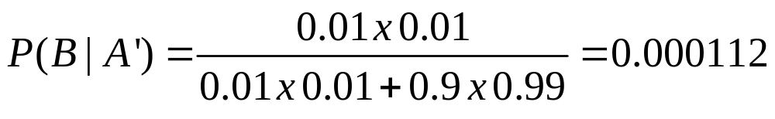
Example : Medical Diagnosis-III
What is the posterior probability of having the disease if you don’t have the symptom:
2. Write down Bayes law as we need to apply it:
3. Substitute and solve:
4. Interpret: How important is this – depends on the disease!

Slide 11
Bayesian Rumpole-I
A man in England was charged with the murder of a woman
The only evidence against him was the DNA match between tissue found on the dead woman’s body, and from the man
Scientists testified that the probability that his DNA would match the tissue from the woman’s body by chance was 1 in 3 million

Slide 12
Bayesian Rumpole-II
Find the posterior probability for the hypothesis that the DNA came from the man, P(Did it| DNA).
Steps:
  specify what is known;
  choose the prior, P(Did it);
  identify what we need calculate; and
  do the calculation.

Slide 13
Bayesian Rumpole-III
What prior did you assume for P(did it)?
Show the sensitivity to your prior and see how important the choice of prior is.

Slide 14
The Prisoner’s Dilemma-I
Consider three prisoners A, B and C. One will be pardoned, two will be executed. Define P(X) as the probability of prisoner X being released.
In the absence of other information, it seems reasonable to assume P(A)=P(B)=P(C)=1/3.
Now the warden enters prisoner A’s cell and tells him that prisoner B will be executed, i.e. the event W(A,B) has occurred.
Should prisoner A rejoice because his probability of execution has dropped to ½?

Slide 15
The Prisoner’s Dilemma-II
What do we know:
  The datum is W(A,B)
  The probability of the data given the hypothesis is:
    P(W(A,B)|A) = 0.5;P(W(A,C)|A) =0.5;P(W(A,A)|A)=0
    P(W(A,B)|B) = 0;P(W(A,C)|B) =1;P(W(A,A)|B)=0
    P(W(A,B)|C) = 1;P(W(A,C)|C) =0;P(W(A,A)|C)=0

Slide 16
Genotypes-I
Let θ denote the proportion of people in England with genotype Z. You take a random sample of 2500 and find 50 with the genotype.
Assume that P(θ) is beta distribution with α=30 and β=470, i.e. prior mean of 0.06.
Calculate the posterior distribution, P(θ|data).

Slide 17
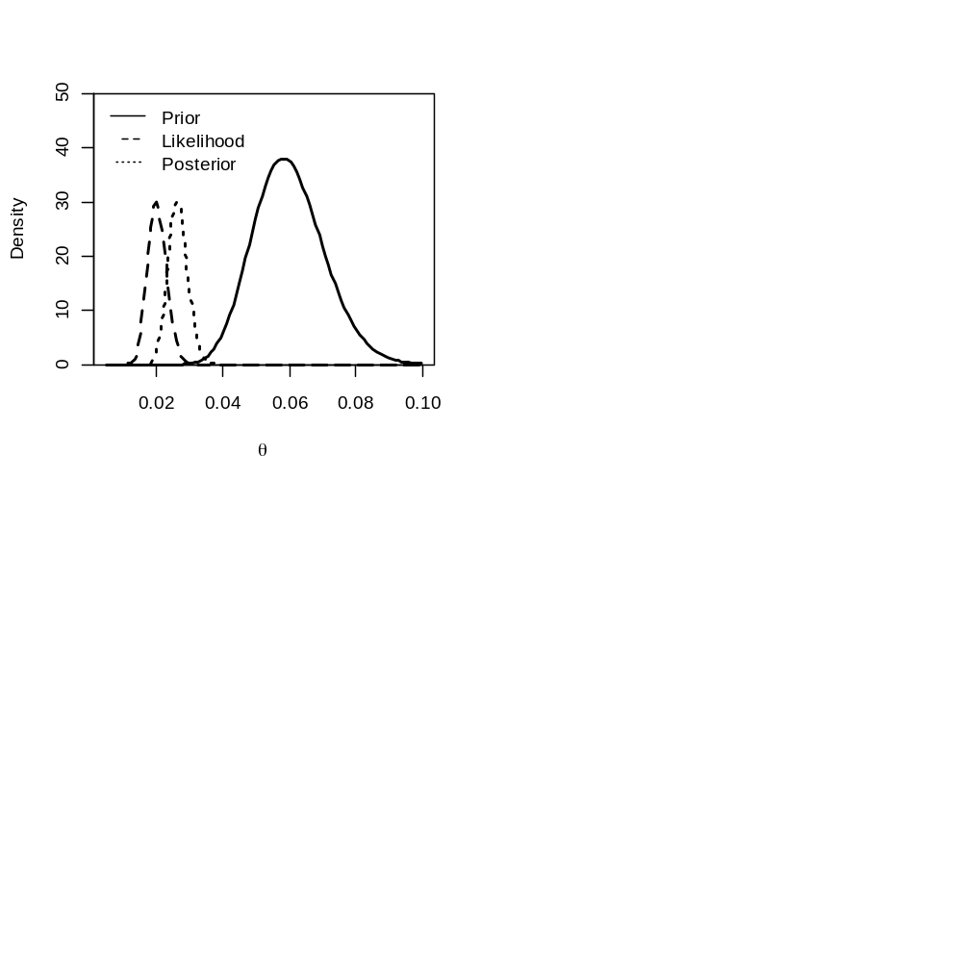
Genotypes-II
Examine the sensitivity to different prior specifications

Slide 18
Genotypes-III
Notes:
  I evaluated the posterior by discretizing the parameter θ into 100 intervals and evaluating the prior, the likelihood, and the product of the likelihood and the prior at the mid-point of each interval.
  This is a numerical method for constructing the posterior distribution. Discretizing each variable and evaluating the posterior by calculating the product of the likelihood and the prior for each combination of parameters is known as the grid search method – this method is easy to implement, but:
    its accuracy depends on the number of intervals; and
    it can get very computationally intensive for a large (>4) number of parameters and / or a large number of intervals.
  We seldom use the grid search method except for very simple problems.

Slide 19
Genotypes-IV
Notes:
  We could have solved this problem analytically and written down the posterior for θ as a function of the data and the prior. This is because a binomial likelihood and a beta prior are said to be conjugate, i.e. the posterior is another beta distribution.
  Other examples of conjugate priors / likelihoods are: a) gamma / Poisson; b) normal / normal; and c) multinomial / Dirichlet.
  Conjugate priors / likelihoods are not available for most of the management-related problems we will be interested in – we take this no further and rely on numerical methods.

Slide 20
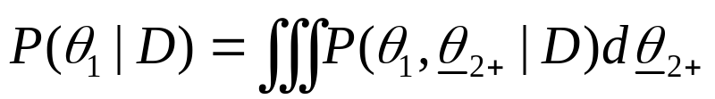
Marginal Posteriors-I
We just produced a joint posterior for the parameters P₁₉₆₈ and α. How do we calculate the posterior for just one of these parameters, the marginal posterior.
The marginal posterior for a parameter θ₁ is obtained by summing (or integrating) over all other parameters, i.e.:
Calculate the marginal posteriors for P₁₉₆₈ and α.

Slide 21
Marginal Posteriors-II
It is possible to determine a marginal posterior for any model output (not just the parameters).
For the grid search method, this involves discretizing the value of the output of interest, assigning each combination of parameters to one of the intervals, and summing the probabilities for each interval for the output of interest.
We will explore this further using samples from the posterior distribution.

Slide 22
Assigning Probabilities to Models-I
(Introduction)
It is possible to assign probabilities to models. These can be used to select among models (if needed).
Approaches:
  Nested models – try to make all the models special cases of a very general model so that calculating the posterior distribution implicitly integrates over models. However, this approach can be numerically “troublesome”.
  Non-nested models (e.g. start the model in 1900 / start the model in 1950) – DIC, and Bayes factor.

Slide 23

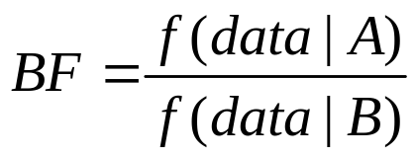
Assigning Probabilities to Models-II
(Bayes Factors-I)
To compare models A and B.
  Fit models A and B.
  Calculate f(data|A), the marginal likelihood:
  Calculate the Bayes factor:
  The information to select among models depends on the ratio of the posterior to the prior odds. The model that has the greatest increase from the prior to the posterior has the greater explanatory power.

Slide 24
Assigning Probabilities to Models-III
(Bayes Factors-II)
BF 2log(BF) Conclusion
< 1 < 0 negative (favor B?)
1 to 3 0 to 2 small, favor A
3 to 12 2 to 5 positive
12 to 150 5 to 10 strong
> 150 > 10 very strong

Slide 25
Assigning Probabilities to Models-IV
(Bayes Factors-III)
Conceptually, the Bayes Factor is the ideal way to assign probabilities to models / select among models. However:
  The calculation of the Bayes Factor can be very non-trivial (occasional small likelihoods can cause the Bayes factor to be unstable).
  The test may be “liberal” in rejecting simpler models.

Slide 26

Assigning Probabilities to Models-IV
(DIC)
DIC is a “Bayesian Analogue” of AIC and is generally
calculated using samples from the posterior distribution:
Notes:
1. p_{D} may be much smaller than the actual number of
parameters because of the impact of the priors.
2. The posterior mean may be an inappropriate measure.

Slide 27

Posterior Predictive Checks-I
After fitting the model, we may want to check whether the model is “good” at predicting both the data and future observations.
We do this using by computing the posterior predictive distribution:
We can create this distribution using samples from the posterior, how?
Probability of the data
given the model
The posterior
distribution

Slide 28
Posterior Predictive Checks-II
We can test the quality of the fit by comparing the posterior predictive distributions for the data with the data themselves:
  central tendency;
  outliers.

Slide 29
But aren’t Bayesian methods highly controversial??

Slide 30
Assigning Probabilities
(Alternative approaches)
Alternatives / frequentist methods:
  The 95% confidence interval for a regression slope does not claim there is a 95% probability that the slope is in that range; rather only that if the experiment was repeated many times, 95% of the times the estimated slope would be in that range.
  Bootstrapping:
    easy to do (except for convergence to local minima);
    doesn’t provide the probability of alternative hypotheses;
    no way to formally incorporate priors / auxiliary information (see Poole et al. 1999); and
    no way to assign probabilities to models.
  Likelihood profile:
    very computationally intensive and does not (without considerable effort and careful wording) provide the input needed to conduct projections.

Slide 31
Priors
Negatives:
  Subjective and potentially influential.
  Priors are often selected to be “non informative”, but no prior is really non-informative.
Positives:
  Without them, we cannot calculate the probability of alternative hypotheses!
  Increasingly, priors are being based on the results of meta-analysis (“standing on the shoulders of giants”).
  Always examine the sensitivity of the results to the subjective priors – this is often minimal.

Slide 32
Other Issues
Can you assign probabilities to hypotheses / parameters – there is only one true value?
Traditionally, there has been little focus on residuals, goodness of fit and bias when applying Bayesian analysis. However, Bayesian analogues for these concepts now exist.
Calculating the integrals needed to apply Bayesian analysis can be a major challenge.
This is a very new approach for natural resource problems (true, but look at the summary in Ellison (2004)).

Slide 33
Readings
Ellison, A.M. 2004.Ecology letters 7: 509-520.
Gelman, A., Carlin, J.B., Stern, H.S. and D.B. Rubin. 1995. Bayesian Data Analysis. Chapman and Hall. Kass, R.E. and A.E. Raftery. 1995. J. Am. Statist. Assoc. 90:773-795.
Poole, D., Givens, G.H. and A.E. Raftery. 1999. Fish. Bull US. 97:144-152.
Punt, A.E. and R. Hilborn. 1997. Rev. Fish. Biol. Fish. 7: 35-63.

